Slide 1
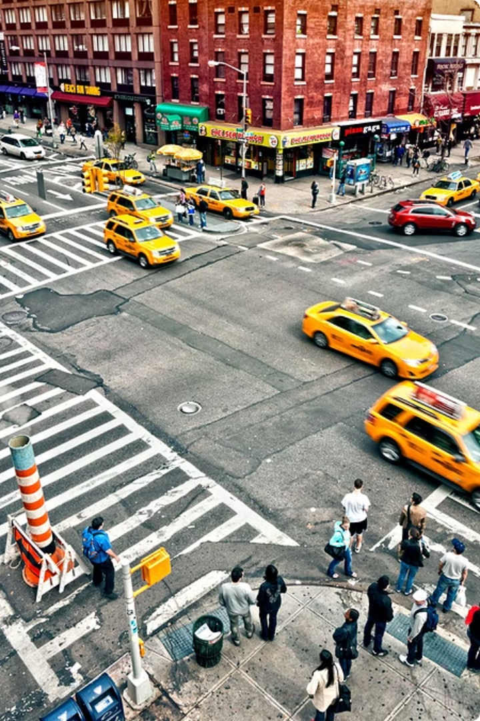
Introduction to Vehicle, Pedestrian Detection, and License Plate Recognition
This presentation explores the cutting-edge computer vision techniques of vehicle detection, pedestrian tracking, and license plate recognition. Leveraging the power of the YOLOV8 deep learning model, we'll dive into the latest advancements in real-time object detection and identification on our roads and streets.

Slide 2
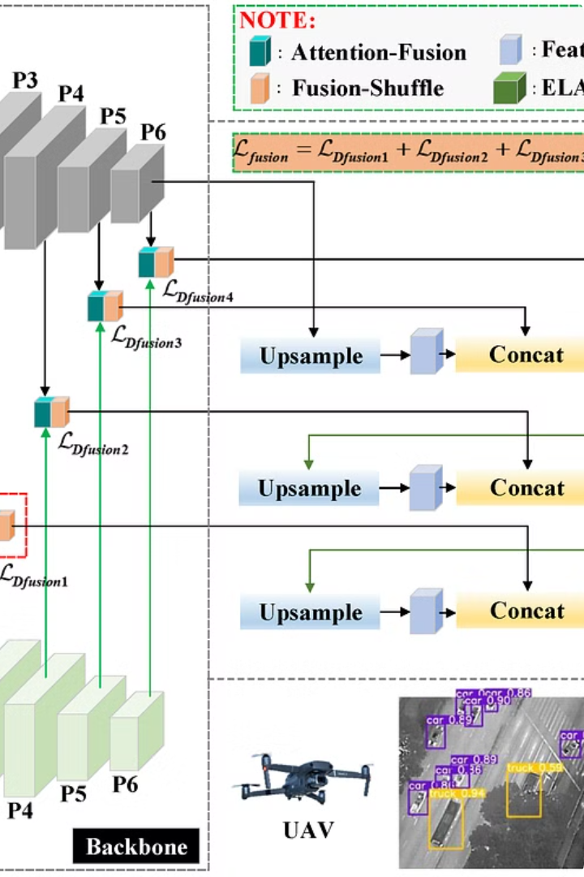
Overview of YOLOV8 Object Detection Model
YOLOV8 is the latest iteration of the revolutionary You Only Look Once (YOLO) object detection model. It builds upon the strengths of previous versions to deliver state-of-the-art performance in real-time object detection and classification.
The YOLOV8 architecture incorporates advanced neural network techniques, such as improved feature extraction and spatial pyramid pooling, to enhance accuracy and speed. Its modular design allows for seamless integration into a variety of computer vision applications.

Slide 3
Preprocessing and Data Preparation
Data Collection
1
Gather a diverse dataset of vehicle, pedestrian, and license plate images from various sources, ensuring representative coverage of different scenarios and conditions.
2
Image Preprocessing
Apply standard image preprocessing techniques such as resizing, cropping, and normalization to prepare the data for effective model training.
Annotation and Labeling
3
Carefully label the images with bounding boxes and class information for vehicles, pedestrians, and license plates to enable supervised learning.

Slide 4
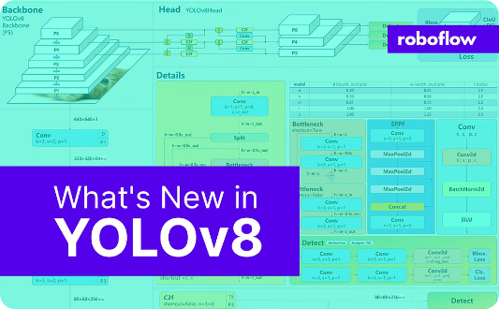
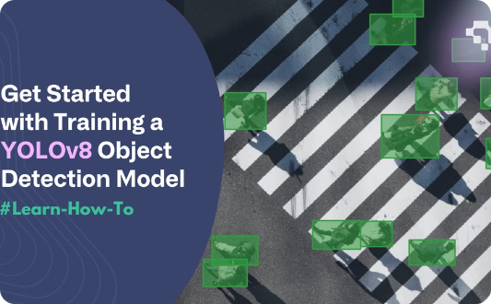
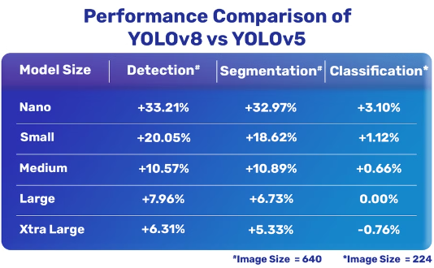
YOLOV8 Model Architecture and Training
Versatile Architecture
Robust Training
State-of-the-Art Performance
The YOLOV8 model features a versatile architecture that enables efficient object detection and classification across a wide range of applications, from autonomous vehicles to surveillance systems.
The training process for YOLOV8 ensures the model learns to accurately detect and classify objects, even in complex environments with varying lighting, occlusion, and camera angles.
YOLOV8 delivers state-of-the-art performance in object detection and classification tasks, with industry-leading accuracy and real-time processing capabilities.

Slide 5
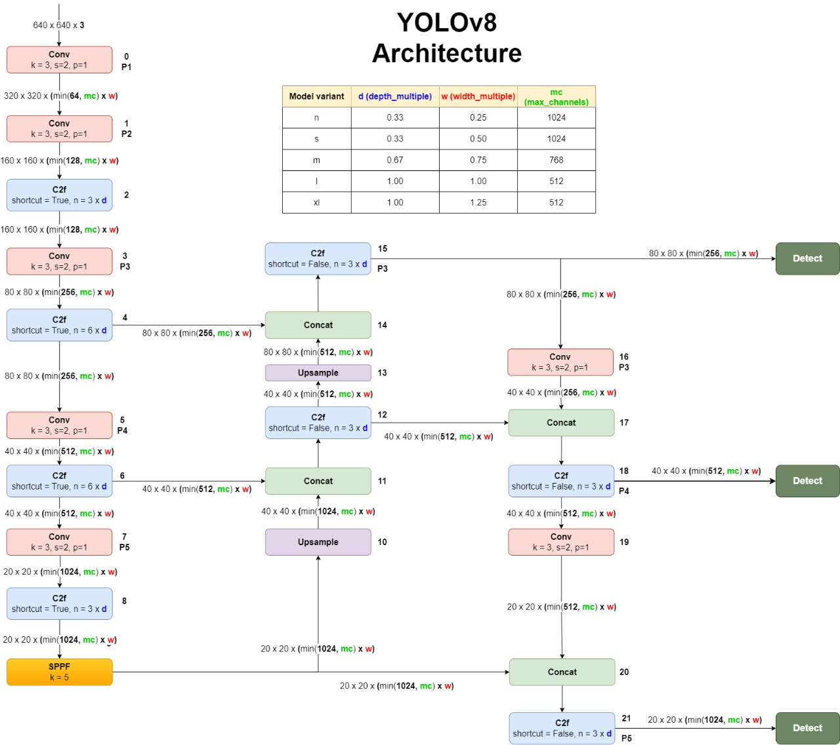
YOLOV8 Original Architecture
Yolov8 is better version in yolo upto now below the is architecture of yolov8. It consists of backbone which is feature extractor followed by neck and then head which contains 3 detect blocks. One detect block is responsible for detecting small object and another two are responsible for detecting medium and large objects. So YOLOv8 can detect almost any object of any size.

Slide 6
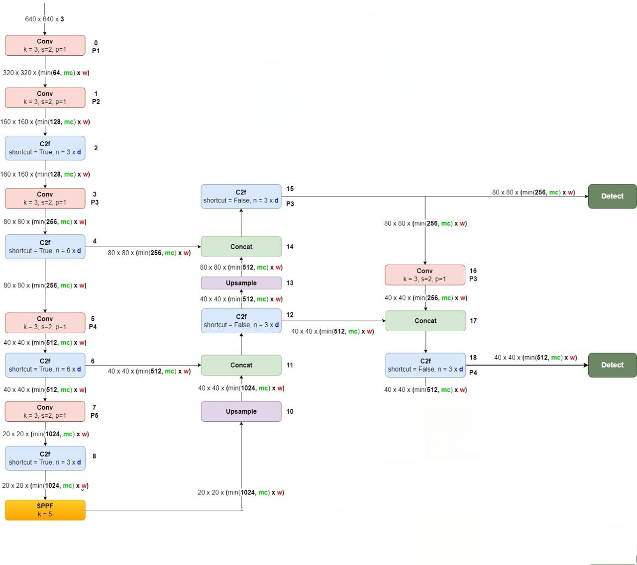
YOLOV8 Modified Architecture
We modified yolov8 orignal architecture inorder to get better detection and better accuracy. In our datasets there no images of large size object so we don’t need a layer to detect the large objects so if we remove that layer there will less number of layers therefore less computation and better accuracy and improvement in speed.
Below is the modifed yolov8 architecture

Slide 7
Platform:
Jupyter Notebook
Google Colab
Pycharm
Configuration:
Processor: 13th Gen Intel Core-i5 2.60 GHz
GPU: Cuda 1.0.12
Datasets Used:
Kitti Dataset
Visdrone Dataset
Highway Dataset
Inria Dataset
License Plate Dataset

Slide 8
Vehicle Detection and Tracking
Object Detection
1
Utilize YOLOV8 to detect vehicles
Localization
2
Determine the precise location of each vehicle
Tracking
3
Follow the movement of detected vehicles over time
By leveraging the power of YOLOV8, our system can accurately detect and locate vehicles within the camera's view. We then employ advanced tracking algorithms to maintain the identity and trajectory of each detected vehicle, enabling us to monitor their movements in real-time. This comprehensive approach allows for robust vehicle monitoring and analysis.

Slide 9



Pedestrian Detection and Tracking
Detect
1
Identify pedestrians in the video feed using YOLOV8
Track
2
Follow the movement of each pedestrian across the scene
Analyze
3
Extract detailed information about each pedestrian's trajectory and behavior
The pedestrian detection and tracking module in our system utilizes the power of YOLOV8 to identify people in the video stream and follow their movements across the scene. By detecting and tracking pedestrians, we can gather valuable insights about foot traffic patterns, pedestrian behavior, and potential safety risks. This information can then be used to optimize urban planning, improve traffic flow, and enhance overall public safety.

Slide 10



Speed Estimation
Vehicle Detection
Distance Calculation
Time Measurement
Using the YOLOV8 object detection model, vehicles are accurately identified and tracked on the road.
The distance traveled by the vehicle is determined by analyzing the change in position of the vehicle in consecutive frames.
The time elapsed between the vehicle's positions is measured precisely to calculate its speed.

Slide 11
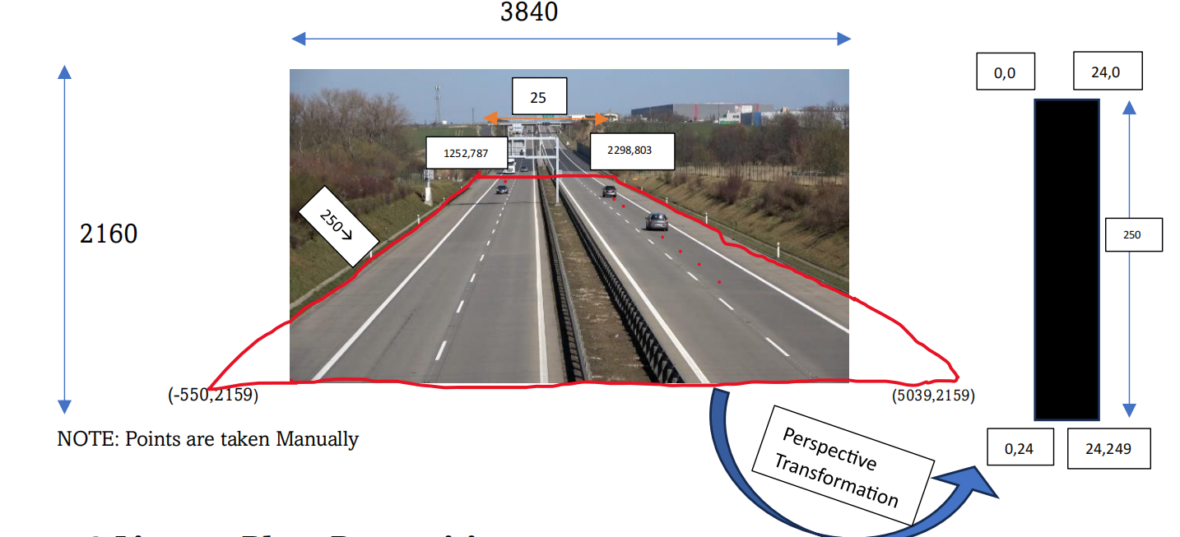
Percpective Transformation
We used percpective transformation which is a in bulid module in supervision library to convert the image coordinate into realworld coordinates to get better estimation in speed.

Slide 12




License Plate Recognition
Image Capture
Utilize high-resolution cameras to capture clear images of vehicle license plates, even in low-light or fast-moving conditions.
Plate Localization
Employ advanced computer vision techniques to precisely locate and isolate the license plate region within the captured image.
Character Segmentation
Segment the license plate characters into individual elements, preparing them for optical character recognition.
Optical Character Recognition
Apply deep learning-based OCR models to accurately identify the individual alphanumeric characters on the license plate.

Slide 13
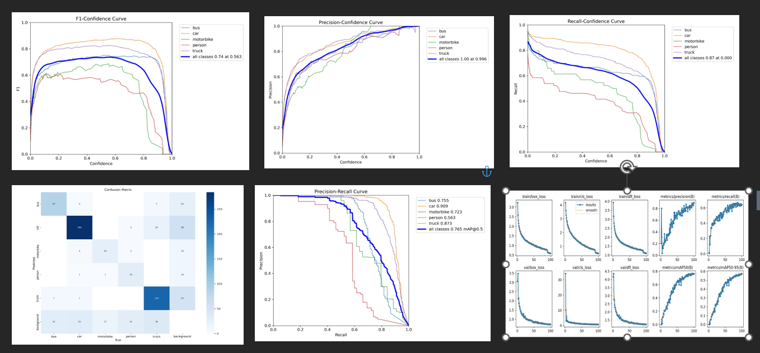
Results and Stats
Highway dataset:

Slide 14
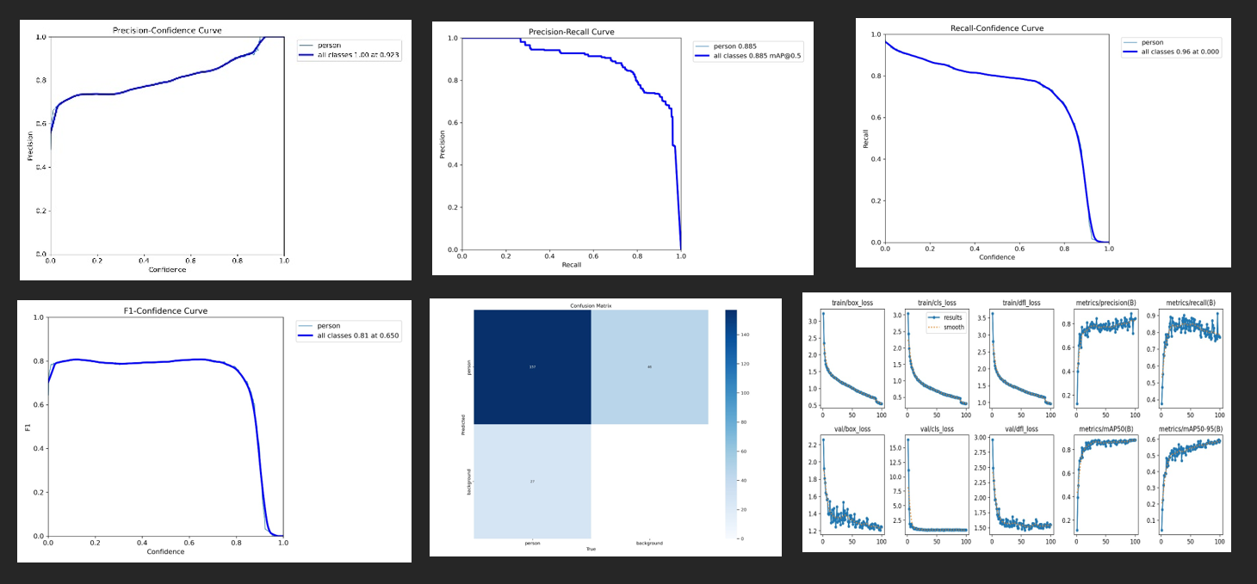
Inria dataset:

Slide 15
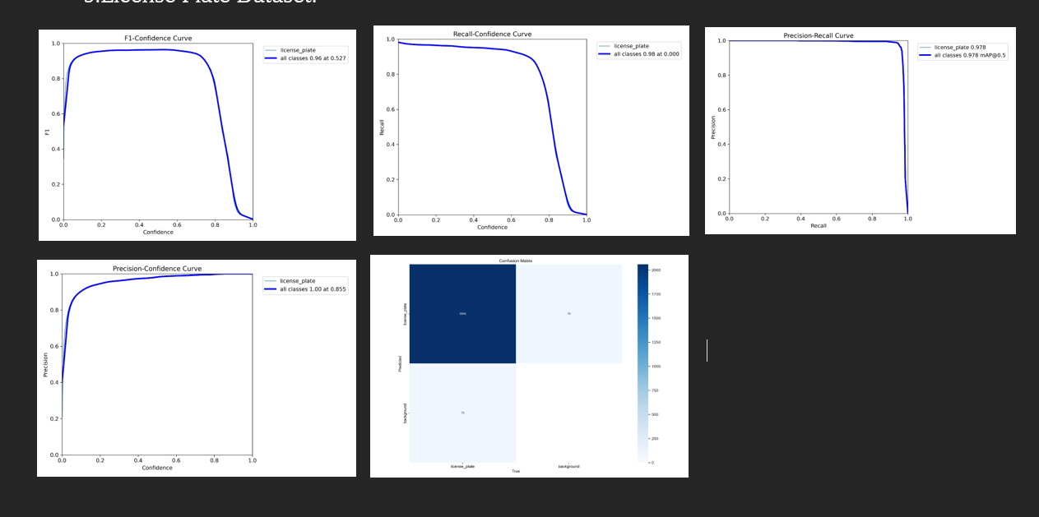
Licence Plate dataset:

Slide 16
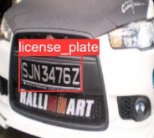
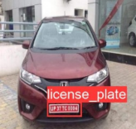
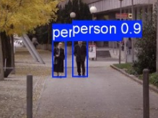
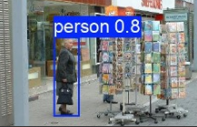
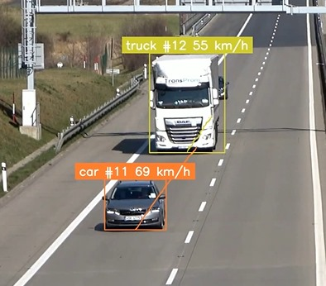
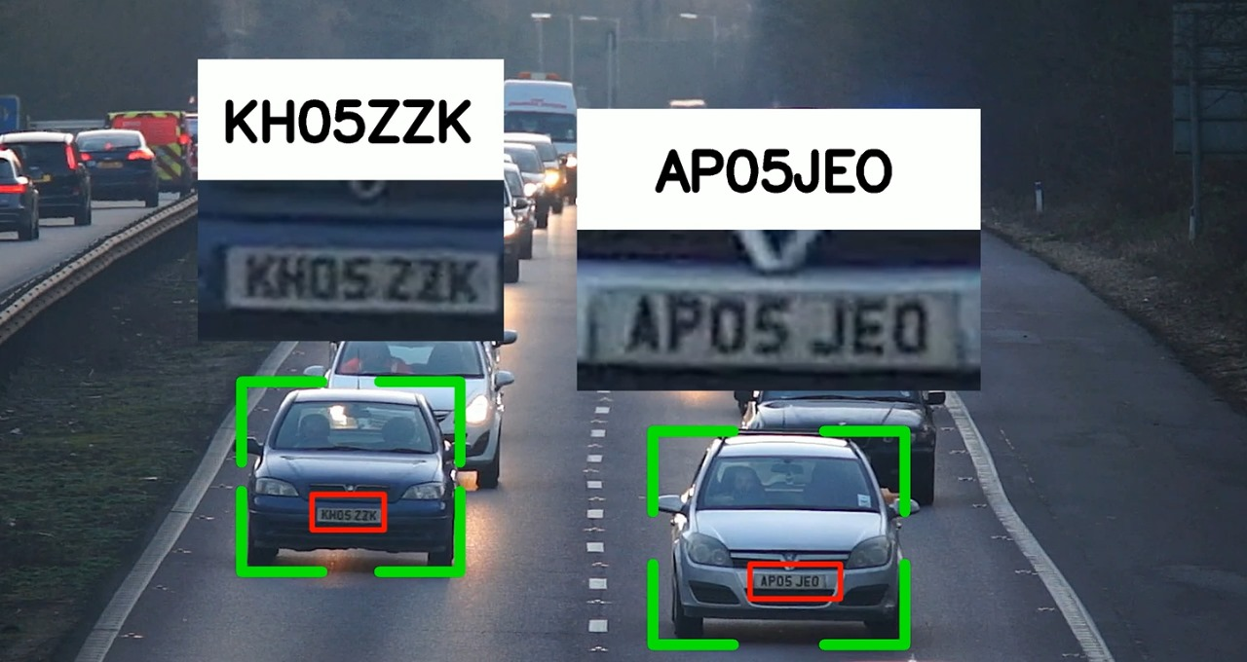
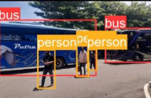
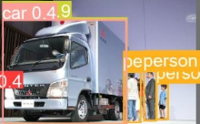
Detections:
License Plate dataset Detections
Inria dataset detections
Highway dataset Detections
Speed Estimation and License Plate Recognition

Slide 17
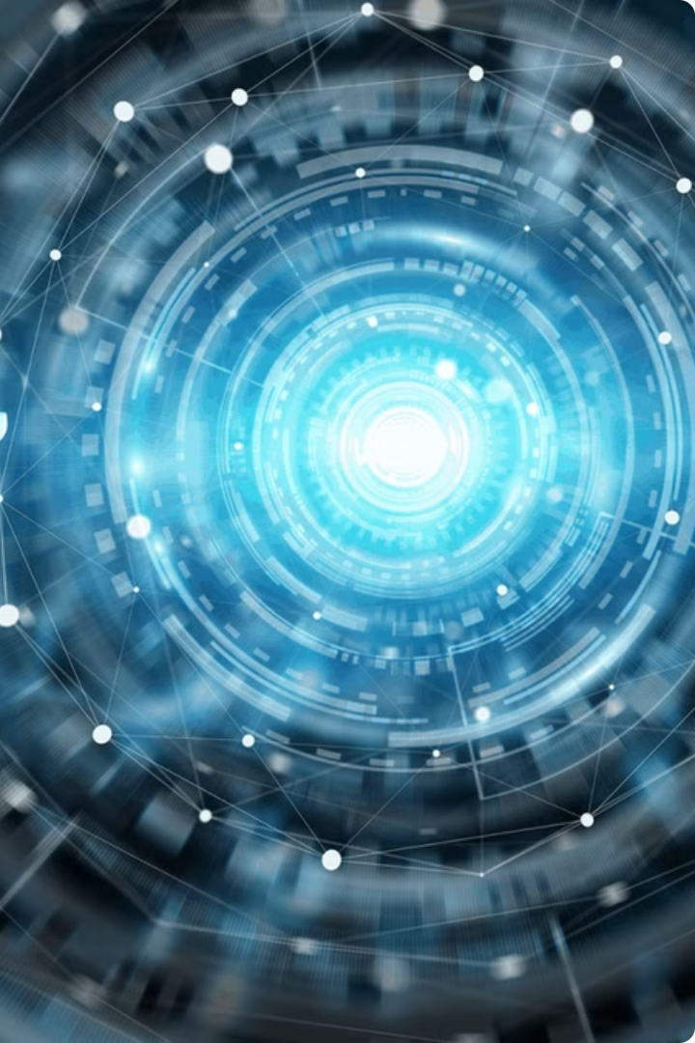
Conclusion
In summary, we efficiently tuned the YOLOv8model for small to medium-sized objects, bringing about a good boost in speed and accuracy for real-time applications. Targeted removal of layers responsible for large object detection has leanified the architecture to be more compliant with our dataset characteristics. It has such refinement that not only brings about
significantly higher computational efficiency but greatly enhances model precision in particular object detection and classification tasks.
References:
Vehicle License Plate Detection and Recognition Using Neural Network | IEEE Conference Publication | IEEE Xplore
Enhancing automated vehicle identification by integrating YOLO v8 and OCR techniques for high-precision license plate detection and recognition | Scientific Reports (nature.com)
Sensors | Free Full-Text | Vehicle Detection Algorithms for Autonomous Driving: A Review (mdpi.com)
Pedestrian Detection: An Evaluation of the State of the Art | IEEE Journals & Magazine | IEEE Xplore
OpenCV Vehicle Detection, Tracking, and Speed Estimation - PyImageSearch

